Slide 1
Advanced Java Programming B.Sc.CSIT Seventh Semester
By Narayan Subedi

Slide 2
Unit 4: Database Connectivity

Slide 3
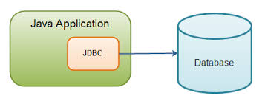
Database Connectivity
What is JDBC?
JDBC is a standard Java API for database-independent connectivity between the Java programming language and a wide range of databases.
Making a connection to a database
Creating SQL or MySQL statements
Executing that SQL or MySQL queries in the database
Viewing & Modifying the resulting records

Slide 4
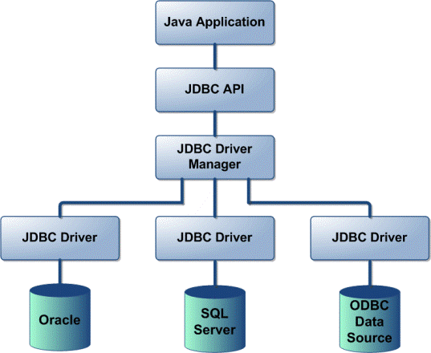
4.1 Design of JDBC
JDBC Driver Types
JDBC driver implementations vary because of the wide variety of operating systems and hardware platforms in which Java operates.
Sun has divided the implementation types into four categories, Types 1, 2, 3, and 4, which is explained below:
Type 1: JDBC-ODBC Bridge Driver:
Type 2: JDBC-Native API:
Type 3: JDBC-Net pure Java:
Type 4: 100% pure Java:
Reference
http://www.tutorialspoint.com/jdbc/jdbc-driver-types.htm

Slide 5
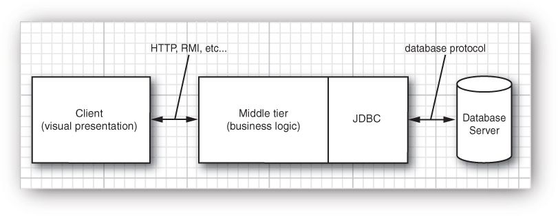
4.1 Design of JDBC
Typical Uses of JDBC

Slide 6
4.2 JDBC Configuration

Slide 7
4.1 Design of JDBC
Relational Database Overview
A database is a means of storing information in such a way that information can be retrieved from it.
In simplest terms, a relational database is one that presents information in tables with rows and columns.
A table is referred to as a relation in the sense that it is a collection of objects of the same type (rows).
Data in a table can be related according to common keys or concepts, and the ability to retrieve related data from a table is the basis for the term relational database. A Database Management System (DBMS) handles the way data is stored, maintained, and retrieved.
In the case of a relational database, a Relational Database Management System (RDBMS) performs these tasks.

Slide 8
Java Database Programming
JDBC API
JDBC API is a Java API that can access any kind of tabular data, especially data stored in a Relational Database. JDBC works with Java on a variety of platforms, such as Windows, Mac OS, and the various versions of UNIX.
java.sql package

Slide 9
Java Database Programming
Driver Manager and JDBC Drivers
JDBC drivers implement the defined interfaces in the JDBC API for interacting with your database server.
An individual database system is accessed via a specific JDBC driver that implements the java.sql.Driver interface.
Drivers exist for nearly all popular RDBMS systems, though few are available for free.
Sun bundles a free JDBC-ODBC bridge driver with the JDK to allow access to standard ODBC data sources, such as a Microsoft Access database.
An easy way to load the driver class is to use the Class.forName() method:
Class.forName("sun.jdbc.odbc.JdbcOdbcDriver");

Slide 10
Java Database Programming
Driver Manager and JDBC Drivers
When the driver is loaded into memory, it registers itself with the java.sql.DriverManager class as an available database driver.
The next step is to ask the DriverManager class to open a connection to a given database, where the database is specified by a specially formatted URL. The method used to open the connection is DriverManager.getConnection() . It returns a class that implements the java.sql.Connection interface:
Connection con = DriverManager.getConnection("jdbc:odbc:somedb", "user", "passwd");

Slide 11
Java Database Programming
Introduction to ODBC
ODBC (Open Database Connectivity) is a standard programming language middleware API for accessing database management systems (DBMS).
The designers of ODBC aimed to make it independent of database systems and operating systems. An application written using ODBC can be ported to other platforms, both on the client and server side, with few changes to the data access code.
ODBC was originally developed by Microsoft during the early 1990s.

Slide 12
Java Database Programming
Connecting Database using JDBC ODBC Driver

Slide 13
Web Programming Using Java Servlet APIs

Slide 14
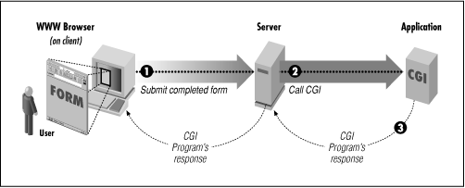
Web Programming Using Java Servlet APIs
Introduction to CGI
Common Gateway Interface (CGI) are programs run by the web server (at "server side").
CGI is a standard method used to generate dynamic content on Web pages and Web applications. CGI, when implemented on a Web server, provides an interface between the Web server and programs that generate the Web content.

Slide 15
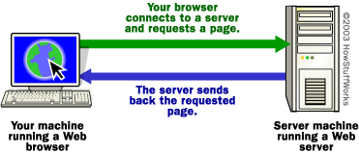
Web Programming Using Java Servlet APIs
Introduction to Web Server
A Web Server is a computer system that processes requests via HTTP.
The term can refer either to the entire system, or specifically to the software that accepts and supervises the HTTP requests.
The most common use of web servers is to host websites, but there are other uses such as gaming, data storage, running enterprise applications, handling email, FTP, or other web uses.

Slide 16
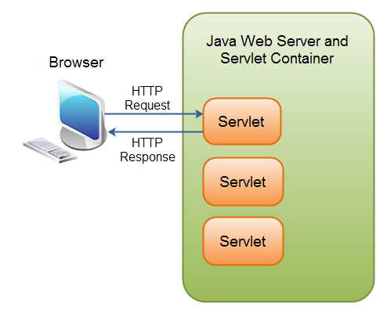
Web Programming Using Java Servlet APIs
Servlet Defination
A Servlet is a small Java program that runs within a Web server.
Servlets receive and respond to requests from Web clients, usually across HTTP, the HyperText Transfer Protocol.
To implement this interface, you can write a generic servlet that extends javax.servlet.GenericServlet or an HTTP servlet that extends javax.servlet.http.HttpServlet.

Slide 17
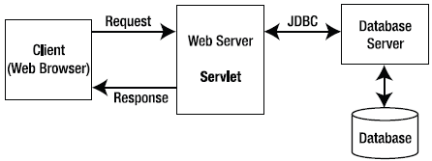
Web Programming Using Java Servlet APIs
HTTP request response model of Servlet

Slide 18
Web Programming Using Java Servlet APIs
Advantages of Servlet over CGI
Better performance: because it creates a thread for each request not process.
Portability: because it uses java language.
Robust: Servlets are managed by JVM so no need to worry about momory leak, garbage collection etc.
Secure: because it uses java language.
Reference
http://www.dineshonjava.com/2013/12/advantages-of-servlets-over-cgi.html#.VMTkxixsvm4
Notes:
A process is an executing instance of an application.

Slide 19
Web Programming Using Java Servlet APIs
Servlet Life Cycle Methods
The init() method :
The init method is designed to be called only once. It is called when the servlet is first created, and not called again for each user request.
public void init() throws ServletException { // Initialization code... }
The service() method :
The servlet container (i.e. web server) calls the service() method to handle requests coming from the client( browsers) and to write the formatted response back to the client.
The service () method is called by the container and service method invokes doGet, doPost, doPut, doDelete, etc. methods as appropriate.
public void service(ServletRequest request, ServletResponse response) throws ServletException, IOException{ }
Notes:
A process is an executing instance of an application.

Slide 20
Web Programming Using Java Servlet APIs
Servlet Life Cycle Methods
The doGet() Method
A GET request results from a normal request for a URL or from an HTML form that has no METHOD specified and it should be handled by doGet() method.
public void doGet(HttpServletRequest request, HttpServletResponse response) throws ServletException, IOException { // Servlet code }
The doPost() Method
A POST request results from an HTML form that specifically lists POST as the METHOD and it should be handled by doPost() method.
public void doPost(HttpServletRequest request, HttpServletResponse response) throws ServletException, IOException { // Servlet code }
Notes:
A process is an executing instance of an application.

Slide 21
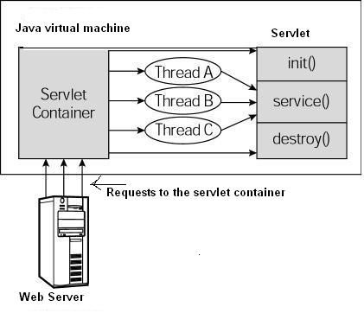
Web Programming Using Java Servlet APIs
Servlet Life Cycle Methods
The destroy() method :
The destroy() method is called only once at the end of the life cycle of a servlet.
public void destroy() { // Finalization code... }
Notes:
A process is an executing instance of an application.

Slide 22
Web Programming Using Java Servlet APIs
Servlet API
javax.servlet
The javax.servlet package contains a number of classes and interfaces that describe and define the contracts between a servlet class and the runtime environment provided for an instance of such a class by a conforming servlet container.
RequestDispatcher : Defines an object that receives requests from the client and sends them to any resource (such as a servlet, HTML file, or JSP file) on the server.
Servlet: Defines methods that all servlets must implement.
ServletConfig : A servlet configuration object used by a servlet container to pass information to a servlet during initialization. ServletContext : Defines a set of methods that a servlet uses to communicate with its servlet container, for example, to get the MIME type of a file, dispatch requests, or write to a log file. …
Notes:
A process is an executing instance of an application.

Slide 23
Web Programming Using Java Servlet APIs
Creating Java Servlet
Compile
servlet-api.jar should be included while doing compile
javac -cp .;F:\apache-tomcat-7.0.23\lib\servlet-api.jar HelloWorld.java
A HelloWolrld.class will be created if compile is success.
Deploy
Copy HelloWorld.class into <Tomcat-installation-directory>/webapps/ROOT/WEB-INF/classes
Notes:
A process is an executing instance of an application.

Slide 24
Web Programming Using Java Servlet APIs
Create following entries in web.xml file located in <Tomcat-installation-directory>/webapps/ROOT/WEB-INF/
<servlet>
<servlet-name>HelloWorld</servlet-name>
<servlet-class>HelloWorld</servlet-class>
</servlet>
<servlet-mapping>
<servlet-name>HelloWorld</servlet-name>
<url-pattern>/HelloWorld</url-pattern>
</servlet-mapping>
Above entries to be created inside <web-app>...</web-app> of web.xml
Now start Tomcat (startup.bat in bin folder of Tomcat installation) and hit http://localhost:8080/HelloWorld in browser.
Notes:
A process is an executing instance of an application.

Slide 25
Web Programming Using Java Servlet APIs
Session
A period devoted to a particular activity.
A session is a way to store information (in variables) to be used across multiple pages.
Saving in Session
String username=request.getParameter("txtusername");
HttpSession session = request.getSession(true);
session.setAttribute("username", username);
Getting from Session
String username=(String) session.getAttribute("username");
//session.invalidate()

Slide 26
Web Programming Using Java Servlet APIs
Cookie
A cookie, also known as an HTTP cookie, web cookie, Internet cookie, or browser cookie, is a small piece of data sent from a website (web application) and stored in a user's web browser while the user is browsing that website (web app).
A cookie, the information is stored on the user’s computer.
Creating Cookie
String username=request.getParameter("txtUsername");
Cookie cookie=new Cookie("username", username); cookie.setMaxAge(60*60*24*30); response.addCookie(cookie);

Slide 27
Web Programming Using Java Servlet APIs
Getting Cookie
Cookie cookies[] = request.getCookies();
Cookie mycookie = null;
if (cookies != null) {
for (int i = 0; i < cookies.length; i++) {
if (cookies[i].getName().equals("username")) {
mycookie = cookies[i];
break;
}
}
}
String userName = mycookie.getValue();

Slide 28
Introductory Concept of Java Beans

Slide 29
Introductory Concept of Java Beans
Java Beans
JavaBeans are classes that encapsulate many objects into a single object (the bean).
They are serializable, have a 0-argument constructor, and allow access to properties using getter and setter methods.
The name "Bean" was to encompass this standard, which aims to create reusable software components for Java.
There is no restriction on the capability of a Bean.
It may perform a simple function, such as obtaining an inventory value, or a complex function, such as forecasting the performance of a stock portfolio.

Slide 30
Introductory Concept of Java Beans
Bean Development Kit (BDK)
BDK is (according to allinterview.com):
Bean Development Kit is a tool that enables to create,configure and connect a set of Beans and it can be used to test Beans without writing a code.
and according to mindprods glossary:
Bean Development Kit. It is now obsolete. Code-building features of modern IDEs take over much of the function of the BDK.
Bean Builder
Bean Builder is a pure Java application, built over market proven and open standards such as XML, Java Beans, and JFC/Swing.
http://www.cs.wustl.edu/~kjg/cs102/Notes/JavaBeans/
http://www.javaworld.com/article/2077005/client-side-java/the-beanbox--sun-s-javabeans-test-container.html

Slide 31
Introductory Concept of Java Beans
Persistance
Persistence is the ability to save the current state of a Bean, including the values of a Bean’s properties and instance variables, to nonvolatile storage and to retrieve them at a later time.
Take Reference from below provided ebook
CHAPTER 29 Java Beans
Java: The Complete Reference™ - Herbert Schildt

Slide 32
Introductory Concept of Java Beans
Creating a New Bean

Slide 33
Questions ???

